Slide 1
CSE 430: Software Testing and Quality Assurance

Slide 2
Lecture 10

Slide 3
Dynamic Testing
White-Box Testing Techniques
Control Flow Graphs examples!

Slide 4
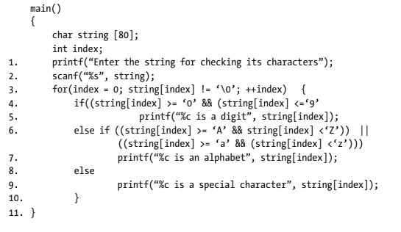
Example 5.2

Slide 5
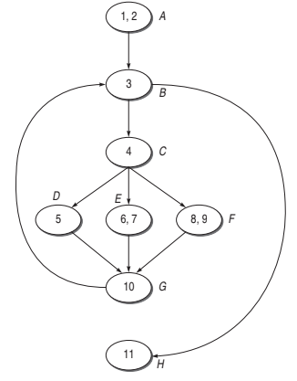
The DD Graph

Slide 6
Cyclomatic Complexity
(i) V(G) = e – n + 2 * P = 10 – 8 + 2 = 4
(ii) V(G) = Number of predicate nodes + 1 = 3 (Nodes B, C) + 1 = 4
Node C is a multiple IF-THEN-ELSE, so for finding out the number
of predicate nodes for this case, follow the following formula:
Number of predicated nodes
= Number of links out of main node − 1
= 3 – 1 = 2 (For node C)
(iii) V(G) = Number of regions = 4

Slide 7
Independent paths
(i) A-B-H
(ii) A-B-C-D-G-B-H
(iii) A-B-C-E-G-B-H
(iv) A-B-C-F-G-B-H

Slide 8
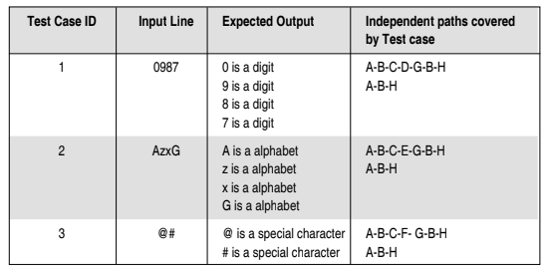
Test case design from the list of independent paths

Slide 9
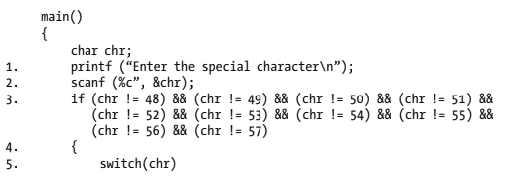
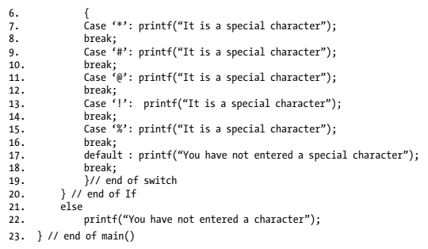
Example 5.3

Slide 10
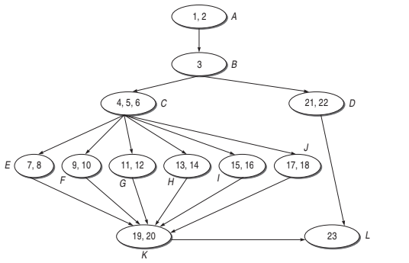
The DD Graph

Slide 11
Cyclomatic COmplexity
(i) V(G) = e – n + 2p= 17 – 12 + 2= 7
(ii) V(G) = Number of predicate nodes + 1= 2 (Nodes B, C) + 1= 7
Node C is a switch-case, so for finding out the number of predicate
nodes for this case, follow the following formula:
Number of predicated nodes
= Number of links out of main node –1
= 6 – 1 = 5 (For node C)
(iii) V(G) = Number of regions = 7

Slide 12
Independent paths
1. A-B-D-L
2. A-B-C-E-K-L
3. A-B-C-F-K-L
4. A-B-C-G-K-L
5. A-B-C-H-K-L
6. A-B-C-I-K-L
7. A-B-C-J-K-L

Slide 13
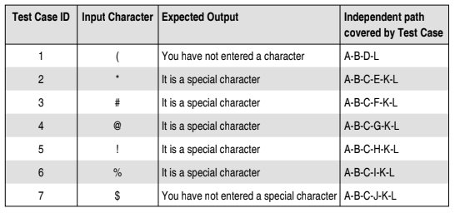
Test Case Design from the list of Independent Paths

Slide 14
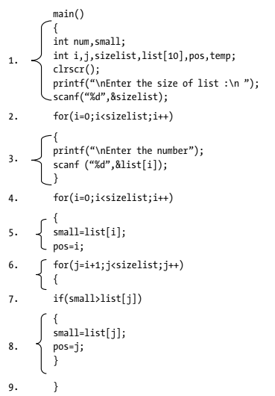
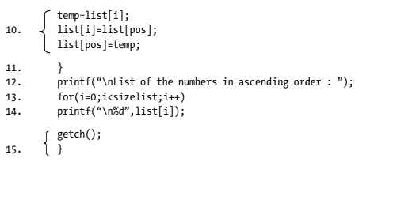
Example 5.4

Slide 15
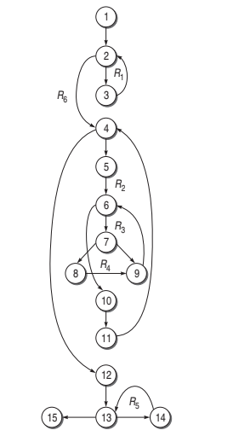
The DD Graph

Slide 16
Cyclomatic complexity
1. V (G ) = e – n + 2p = 19 – 15 +2 = 6
2. V (G ) = Number of predicate nodes + 1 = 5 + 1 = 6
3. V (G ) = Number of regions = 6

Slide 17
Independent paths
1. 1-2-3-2-4-5-6-7-8-9-6-10-11-4-12-13-14-13-15
2. 1-2-3-2-4-5-6-7-9-6-10-11-4-12-13-14-13-15
3. 1-2-3-2-4-5-6-10-11-4-12-13-14-13-15
4. 1-2-3-2-4-12-13-14-13-15 (path not feasible)
5. 1-2-4-12-13-15
6. 1-2-3-2-4-12-13-15 (path not feasible)

Slide 18
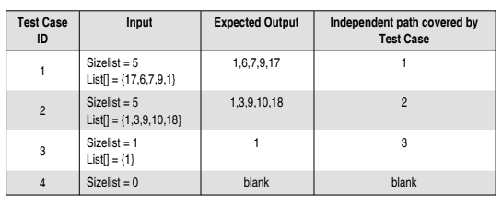
Test Case Design from the list of Independent Paths

Slide 19
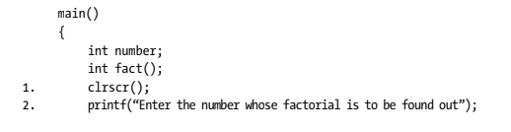
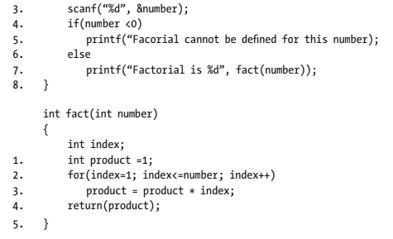
Example 5.5

Slide 20
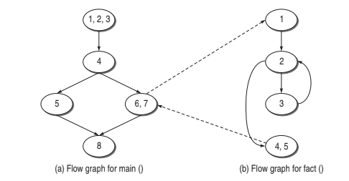
The DD Graph

Slide 21
Cyclomatic complexity of main()
(a) V (M ) = e − n + 2p = 5 – 5 + 2 = 2
(b) V (M ) = d + p = 1 + 1 = 2
(c) V (M ) = Number of regions = 2

Slide 22
Cyclomatic complexity of fact()
(a) V (R ) = e – n + 2p = 4 − 4 + 2 = 2
(b) V (R ) = Number of predicate nodes + 1 = 1 + 1 = 2
(c) V (R ) = Number of regions = 2

Slide 23
Cyclomatic complexity of the whole graph considering the full program
(a) V (G ) = e – n + 2p = 9 − 9 + 2 * 2 = 4 = V (M ) + V (R )
(b) V (G ) = d + p = 2 + 2 = 4 = V (M ) + V (R )
(c) V (G ) = Number of regions = 4 = V (M ) + V (R )

